Slide 1

Eagle Sensitive Information Scanner
Team: NamingException

Slide 2
Scan Requirements
Scan to be run on
Non centralized servers
University owned work stations
Faculty/Staff computers
Lab machines
Searching for personally identifiable information (SSNs)
Scrub the sensitive data

Slide 3

Requirements Continued
Windows XP and 7
High priority file types
.txt, .csv
Microsoft Office (.docx, .doc, .xlsx,
.xls, .pptx, .ppt)
Libre Office (.odt, .ods, .odp)
Outlook database files (.pst, .ost)
.pdf
.xml, xhtml, html
File types to ignore
System files (.exe, .dll, .lib, .cab, .bin, .ini)
Multimedia file (.jpg, .bmp, .gif, .png, .tiff, .mpg, .mp4, .avi)

Slide 4
Priority Work for Winter Quarter
Results written to encrypted database
Program to view database
PST and OST Parser
Credit Card number scanning
New UI
Optimize code
Testing

Slide 5
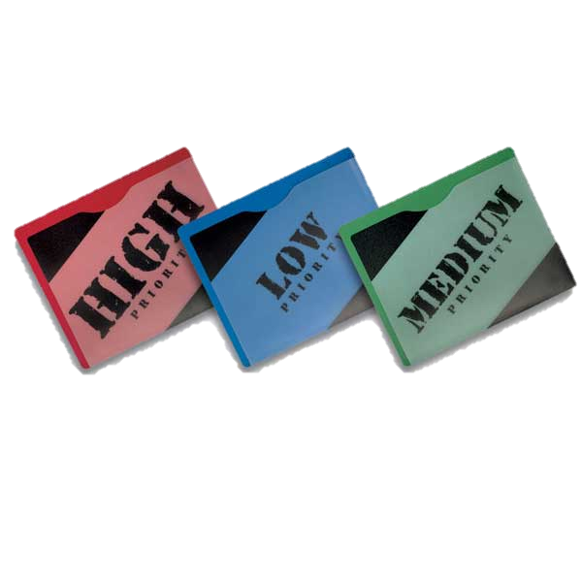
Engine
Keyword based priority system
Avoid False Negatives
Rate files on likelihood of actual sensitive information
Search for Keywords
Credit Card Numbers
Visa, Mastercard, American Express, Discover, etc…
Counting Instances in a file
Total, as well as specific patterns
Memory Structure

Slide 6
Architecture
User Interface
Language: C#
[Note: Windows Forms or WPF]
File Parsers
Language: C#
[Note: .NET COM Objects]
Communication Layer
Sensitive Data Recognition Engine
Language: C/C++ (Visual C/C++)
[Note: Generate .lib or .dll files]

Slide 7
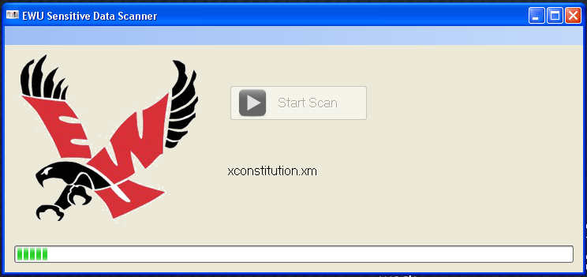
Initial GUI: Version 1.01

Slide 8
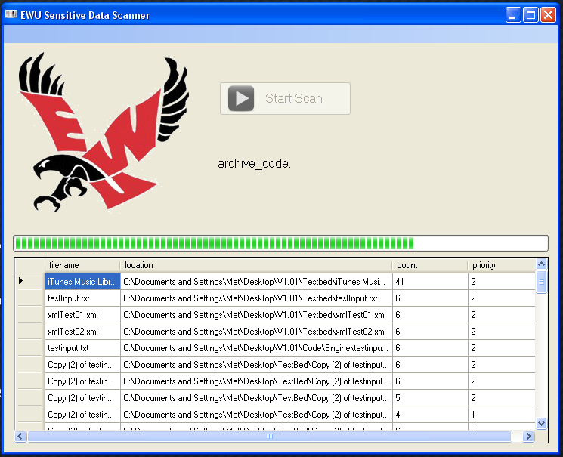
Initial GUI: Version 1.12

Slide 9
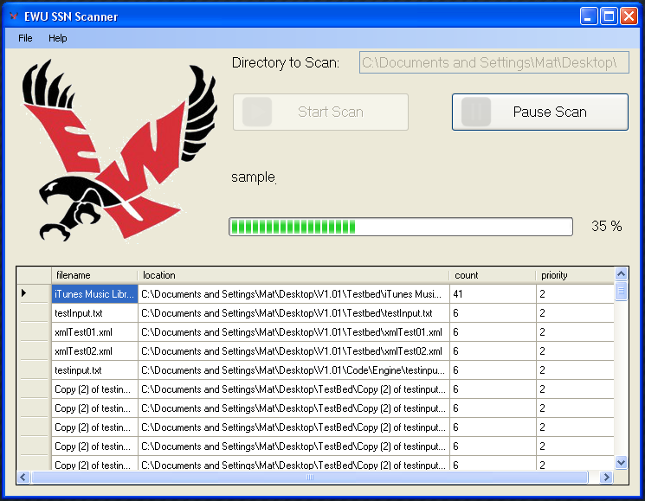
Initial GUI: Version 1.15

Slide 10
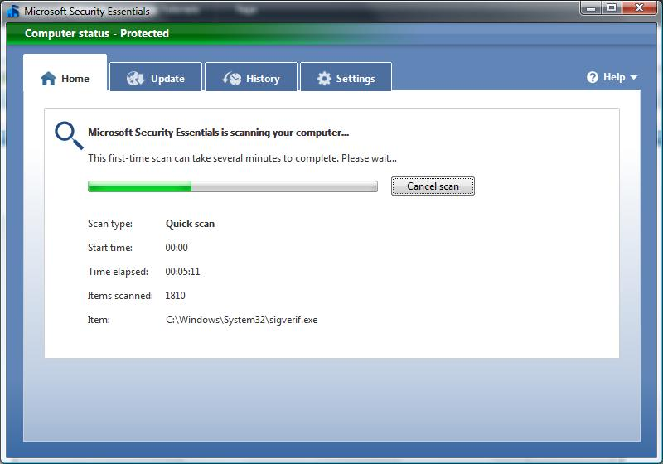
Inspiration

Slide 11
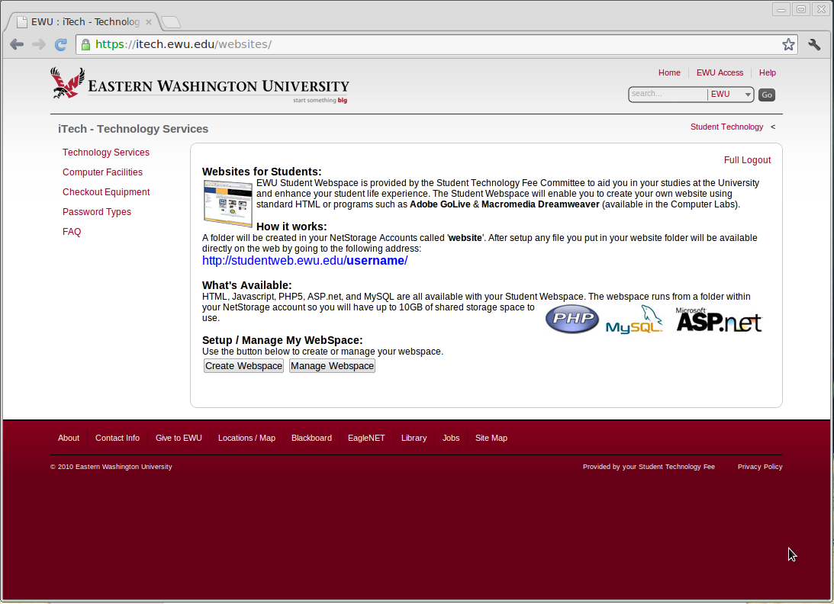
Inspiration

Slide 12
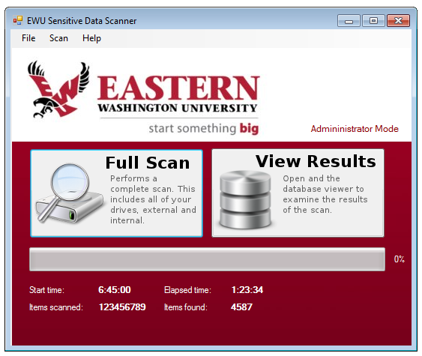
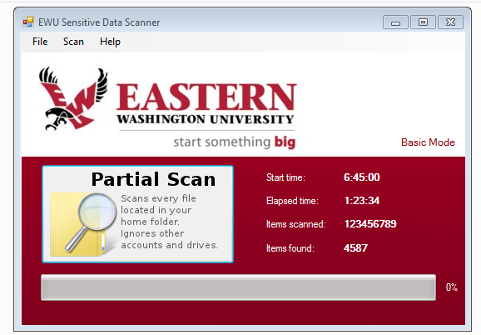
Initial Prototype
Administrator Application
Basic User Application

Slide 13
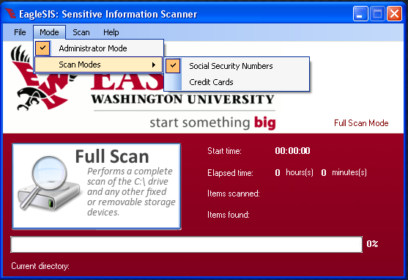
Final GUI

Slide 14

Database
Self-contained and non-server
1st Approach:
Database used for file traversal
handle crash and recovery
Performance problems
2nd Approach:
Query commands with parameters
Current:
Logs social security numbers, credit card numbers, and un-scannable files.

Slide 15
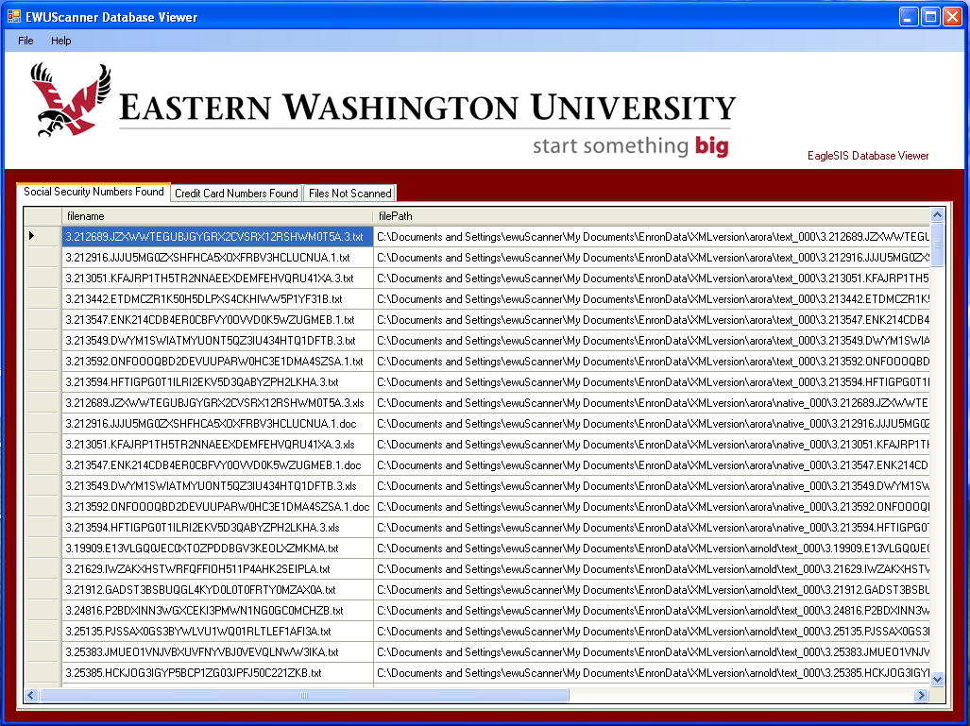
Database Viewer

Slide 16
Magic Numbers
ZIP: 504B030414
DOCX: 504B030414
XLSX: 504B030414
PPTX: 504B030414
PDF: 25504446
PST: 2142444E

Slide 17

Outlook PST and OST Files
Personal Storage Tables and Offline Storage Tables
Contain years of email conversations
Archives
Student SSNs and Student ID numbers
Issues
Interop
Outlook 2003, 2007, 2010 versions
Password Protected

Slide 18
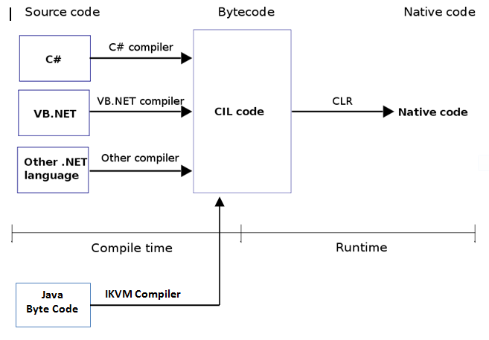

Slide 19
Parser Work and Solutions
Java LibPST
Can call Java libraries from .NET
IKVM.NET
Compiles Java class files into CIL
Conflict with our PDF Parser
New PDF Parser
iTextSharp
Handling Archives within Archives

Slide 20
Testing
Dedicated test machine
Platform with worst case scenario in hardware and Windows Operating system
Test-bed of files testing boundary cases saved in different formats to test parsers
Testing led to modifications of the engine regular expressions

Slide 21


Future Work
Additional Operating Systems
Additional iFilters
Application Recovery
Linux
Apple OSX

Slide 22
Final Words

